Slide 1
Chapter 16 – Project
Management
Operations Management
4th Edition © Wiley 2010
© Wiley 2010

Slide 2
Learning Objectives
Describe project management objectives
Describe the project life cycle
Diagram networks of project activities
Estimate the completion time of a project
Compute the probability of completing a project by a specific time
© Wiley 2010

Slide 3
Learning Objectives – con’t
Determine how to reduce the length of a project effectively
Describe the critical chain approach to project management
© Wiley 2010

Slide 4
Project Management Applications
What is a project?
  Any unique endeavor with specific objectives
  With multiple activities
  With defined precedent relationships
  With a specific time period for completion
Examples?
  A major event like a wedding
  Any construction project
  Designing a political campaign
© Wiley 2010

Slide 5
Project Life Cycle
Conception: identify the need
Feasibility analysis or study: costs benefits, and risks
Planning: who, how long, what to do?
Execution: doing the project
Termination: ending the project
© Wiley 2010

Slide 6
Network Planning Techniques
Program Evaluation & Review Technique (PERT):
  Developed to manage the Polaris missile project
  Many tasks pushed the boundaries of science & engineering (tasks’ duration = probabilistic)
Critical Path Method (CPM):
  Developed to coordinate maintenance projects in the chemical industry
  A complex undertaking, but individual tasks are routine (tasks’ duration = deterministic)
© Wiley 2010

Slide 7
Both PERT and CPM
Graphically display the precedence relationships & sequence of activities
Estimate the project’s duration
Identify critical activities that cannot be delayed without delaying the project
Estimate the amount of slack associated with non-critical activities
© Wiley 2010

Slide 8
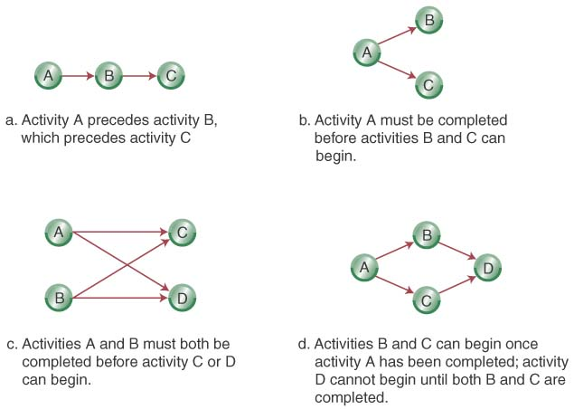
Network Diagrams
Activity-on-Node (AON):
  Uses nodes to represent the activity
  Uses arrows to represent precedence relationships
© Wiley 2007

Slide 9
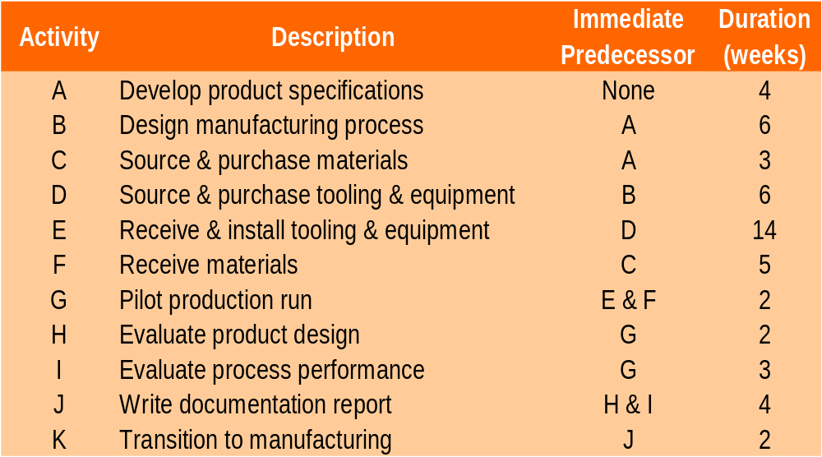
Step 1-Define the Project: Cables By Us is bringing a new product on line to be manufactured in their current facility in existing space. The owners have identified 11 activities and their precedence relationships. Develop an AON for the project.
© Wiley 2010

Slide 10
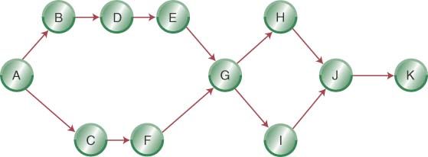
Step 2- Diagram the Network for
Cables By Us
© Wiley 2010

Slide 11
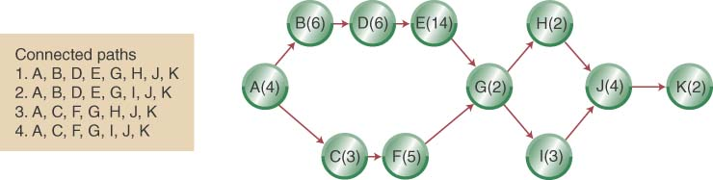
Step 3 (a)- Add Deterministic Time Estimates and Connected Paths
© Wiley 2010

Slide 12
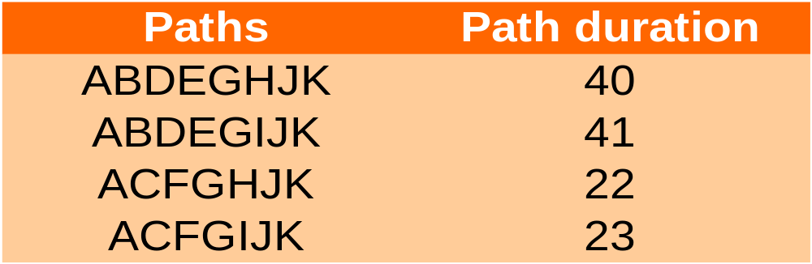
Step 3 (a) (Con’t): Calculate the Project Completion Times
The longest path (ABDEGIJK) limits the project’s duration (project cannot finish in less time than its longest path)
ABDEGIJK is the project’s critical path
© Wiley 2010

Slide 13
Some Network Definitions
All activities on the critical path have zero slack
Slack defines how long non-critical activities can be delayed without delaying the project
Slack = the activity’s late finish minus its early finish (or its late start minus its early start)
Earliest Start (ES) = the earliest finish of the immediately preceding activity
Earliest Finish (EF) = is the ES plus the activity time
Latest Start (LS) and Latest Finish (LF) = the latest an activity can start (LS) or finish (LF) without delaying the project completion
© Wiley 2010

Slide 14
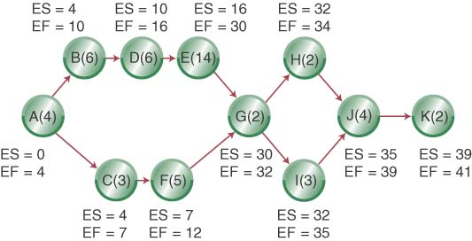
ES, EF Network
© Wiley 2010

Slide 15
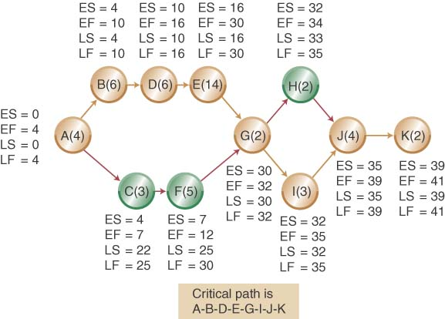
LS, LF Network
© Wiley 2010

Slide 16
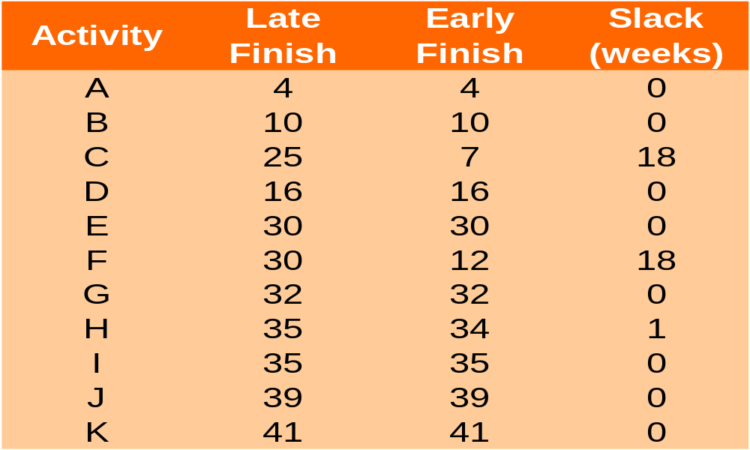
Calculating Slack

Slide 17
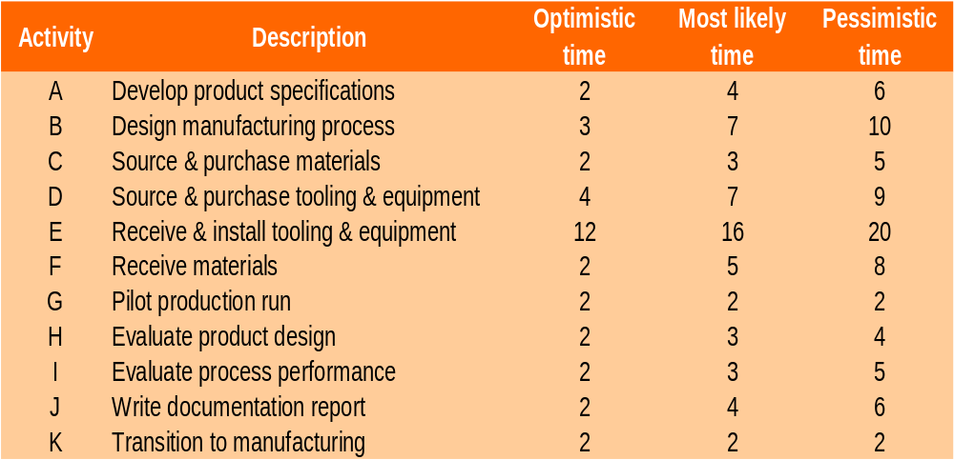
Revisiting Cables By Us Using Probabilistic Time Estimates
© Wiley 2010

Slide 18
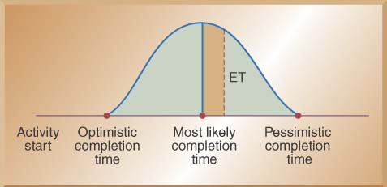
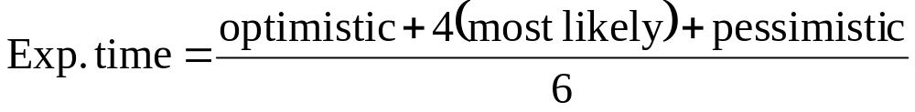
Using Beta Probability Distribution to Calculate Expected Time Durations
A typical beta distribution is shown below, note that it has definite end points
The expected time for finishing each activity is a weighted average

Slide 19
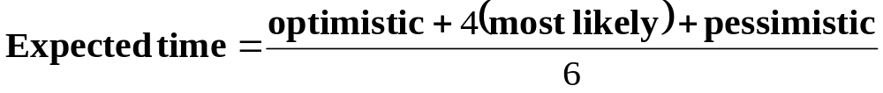
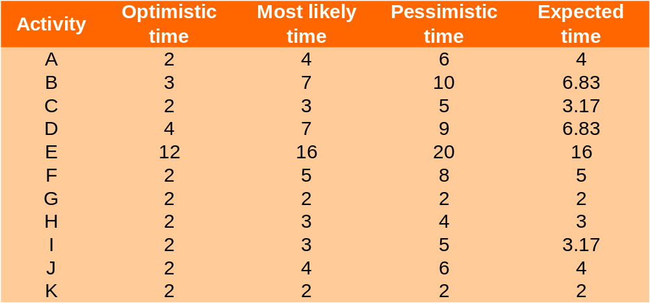
Calculating Expected Task Times
© Wiley 2007

Slide 20
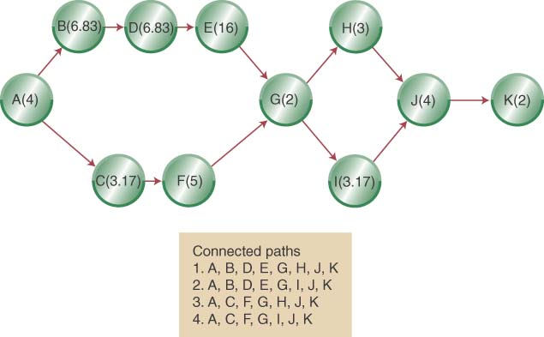
Network Diagram with Expected Activity Times
© Wiley 2010

Slide 21
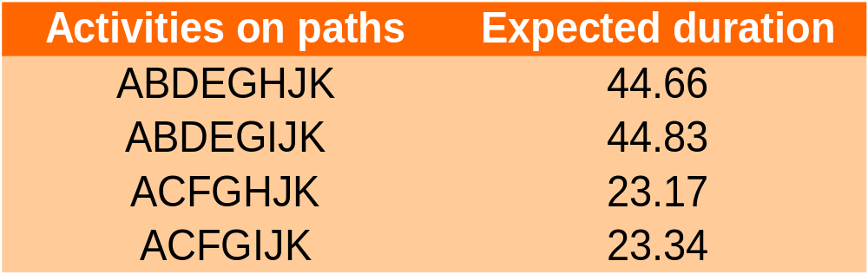
Estimated Path Durations through the Network
ABDEGIJK is the expected critical path & the project has an expected duration of 44.83 weeks
© Wiley 2010

Slide 22
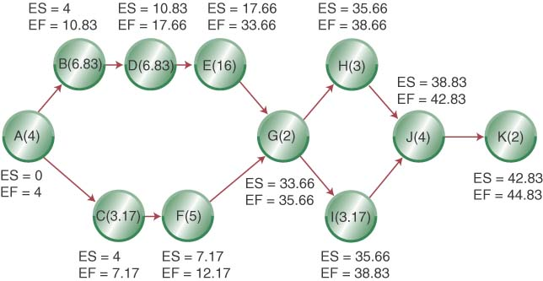
Adding ES and EF to Network
© Wiley 2010

Slide 23
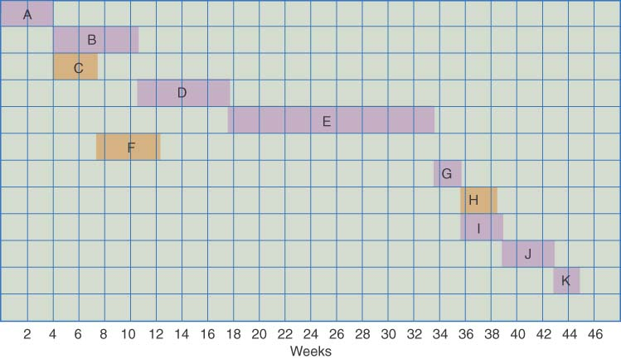
Gantt Chart Showing Each Activity Finished at the Earliest Possible Start Date
© Wiley 2010

Slide 24
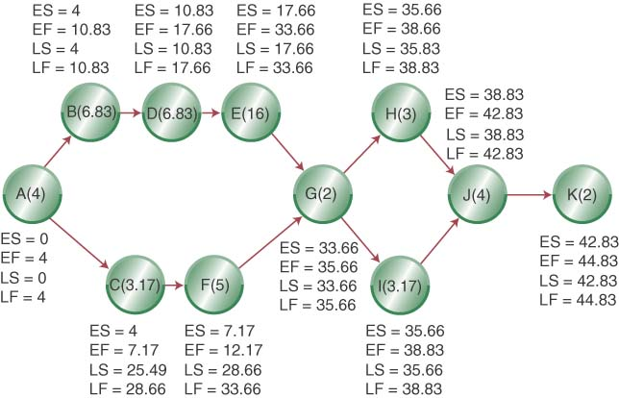
Adding LS and LF to Network
© Wiley 2010

Slide 25
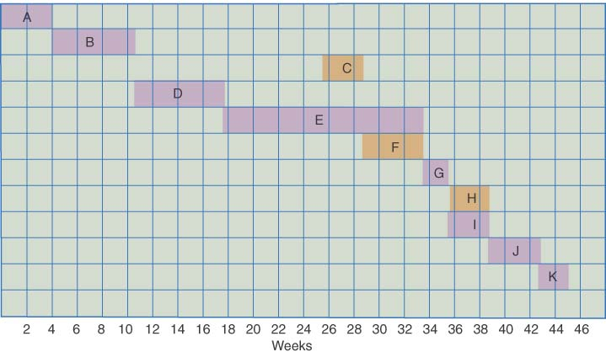
Gantt Chart Showing the Latest Possible Start Times if the Project Is to Be Completed in 44.83 Weeks
© Wiley 2010

Slide 26
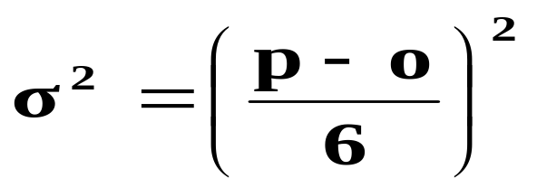
Estimating the Probability of Completion Dates
Using probabilistic time estimates offers the advantage of predicting the probability of project completion dates
We have already calculated the expected time for each activity by making three time estimates
Now we need to calculate the variance for each activity
The variance of the beta probability distribution is:
  where p=pessimistic activity time estimate
o=optimistic activity time estimate
© Wiley 2010

Slide 27
Project Activity Variance
Activity | Optimistic | Most Likely | Pessimistic | Variance
A | 2 | 4 | 6 | 0.44
B | 3 | 7 | 10 | 1.36
C | 2 | 3 | 5 | 0.25
D | 4 | 7 | 9 | 0.69
E | 12 | 16 | 20 | 1.78
F | 2 | 5 | 8 | 1.00
G | 2 | 2 | 2 | 0.00
H | 2 | 3 | 4 | 0.11
I | 2 | 3 | 5 | 0.25
J | 2 | 4 | 6 | 0.44
K | 2 | 2 | 2 | 0.00
© Wiley 2007

Slide 28
Variances of Each Path through the Network
Path Number | Activities on Path | Path Variance (weeks)
1 | A,B,D,E,G,H,J,k | 4.82
2 | A,B,D,E,G,I,J,K | 4.96
3 | A,C,F,G,H,J,K | 2.24
4 | A,C,F,G,I,J,K | 2.38
© Wiley 2010

Slide 29
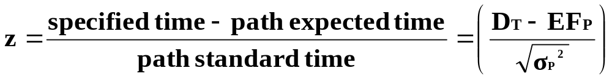

Calculating the Probability of Completing the Project in Less Than a Specified Time
When you know:
  The expected completion time
  Its variance
You can calculate the probability of completing the project in “X” weeks with the following formula:
Where D_{T} = the specified completion date
EFPath = the expected completion time of the path
© Wiley 2010

Slide 30
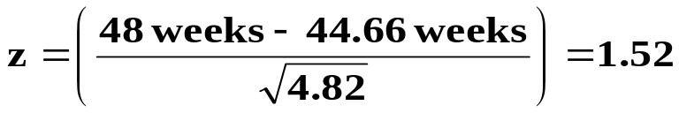
Example: Calculating the probability of finishing the project in 48 weeks
Use the z values in Appendix B to determine probabilities
e.g. probability for path 1 is
Path Number | Activities on Path | Path Variance (weeks) | z-value | Probability of Completion
1 | A,B,D,E,G,H,J,k | 4.82 | 1.5216 | 0.9357
2 | A,B,D,E,G,I,J,K | 4.96 | 1.4215 | 0.9222
3 | A,C,F,G,H,J,K | 2.24 | 16.5898 | 1.000
4 | A,C,F,G,I,J,K | 2.38 | 15.9847 | 1.000
© Wiley 2010

Slide 31
Reducing Project Completion Time
Project completion times may need to be shortened because:
  Different deadlines
  Penalty clauses
  Need to put resources on a new project
  Promised completion dates
Reduced project completion time is “crashing”
© Wiley 2010

Slide 32
Reducing Project Completion Time – con’t
Crashing a project needs to balance
  Shorten a project duration
  Cost to shorten the project duration
Crashing a project requires you to know
  Crash time of each activity
  Crash cost of each activity
Crash cost/duration = (crash cost-normal cost)/(normal time – crash time)
© Wiley 2010

Slide 33
Reducing the Time of a Project (crashing)
Activity | Normal Time (wk) | Normal Cost ($) | Crash Time | Crash Cost ($) | Max. weeks of reduction | Reduce cost per week
A | 4 | 8,000 | 3 | 11,000 | 1 | 3,000
B | 6 | 30,000 | 5 | 35,000 | 1 | 5,000
C | 3 | 6,000 | 3 | 6,000 | 0 | 0
D | 6 | 24,000 | 4 | 28,000 | 2 | 2,000
E | 14 | 60,000 | 12 | 72,000 | 2 | 6,000
F | 5 | 5,000 | 4 | 6,500 | 1 | 1500
G | 2 | 6,000 | 2 | 6,000 | 0 | 0
H | 2 | 4,000 | 2 | 4,000 | 0 | 0
I | 3 | 4,000 | 2 | 5,000 | 1 | 1,000
J | 4 | 4,000 | 2 | 6,400 | 2 | 1,200
K | 2 | 5,000 | 2 | 5,000 | 0 | 0
© Wiley 2007

Slide 34
Crashing Example: Suppose the Cables By Us project manager wants to reduce the new product project from 41 to 36 weeks.
Crashing Costs are considered to be linear
Look to crash activities on the critical path
Crash the least expensive activities on the critical path first (based on cost per week)
  Crash activity I from 3 weeks to 2 weeks $1000
  Crash activity J from 4 weeks to 2 weeks $2400
  Crash activity D from 6 weeks to 4 weeks $4000
  Recommend Crash Cost $7400
Question: Will crashing 5 weeks return more in benefits than it costs?
© Wiley 2010

Slide 35
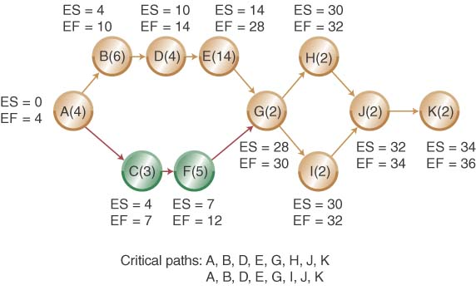
Crashed Network Diagram
© Wiley 2010

Slide 36
The Critical Chain Approach
The Critical Chain Approach focuses on project due dates rather than on individual activities and the following realities:
  Project time estimates are uncertain so we add safety time
  Multi-levels of organization may add additional time to be “safe”
  Individual activity buffers may be wasted on lower-priority activities
  A better approach is to place the project safety buffer at the end
Original critical path
Activity A |  | Activity B |  | Activity C |  |  | Activity D |  | Activity E
Critical path with project buffer
Activity A | Activity B |  | Activity C |  | Activity D | Activity E |  | Project Buffer
© Wiley 2010

Slide 37
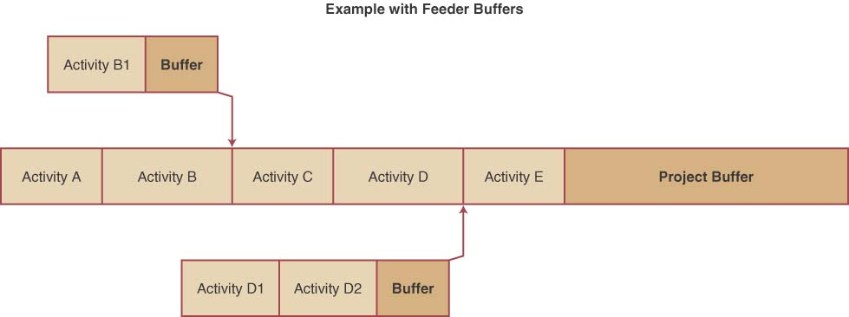
Adding Feeder Buffers to Critical Chains
The theory of constraints, the basis for critical chains, focuses on keeping bottlenecks busy.
Time buffers can be put between bottlenecks in the critical path
These feeder buffers protect the critical path from delays in non-critical paths
© Wiley 2007

Slide 38
Project Management within OM: How it all fits together
Project management techniques provide a structure for the project manager to track the progress of different activities required to complete the project. Particular concern is given to critical path (the longest connected path through the project network) activities.
Any delay to a critical path activity affects the project completion time. These techniques indicate the expected completion time and cost of a project. The project manager reviews this information to ensure that adequate resources exist and that the expected completion time is reasonable.
© Wiley 2010

Slide 39
Project Management OM Across the Organization
Accounting uses project management (PM) information to provide a time line for major expenditures
Marketing use PM information to monitor the progress to provide updates to the customer
Information systems develop and maintain software that supports projects
Operations use PM to information to monitor activity progress both on and off critical path to manage resource requirements
© Wiley 2010

Slide 40
Chapter 16 Highlights
A project is a unique, one time event of some duration that consumes resources and is designed to achieve an objective in a given time period.
Each project goes through a five-phase life cycle: concept, feasibility study, planning, execution, and termination.
Two network planning techniques are PERT and CPM. Pert uses probabilistic time estimates. CPM uses deterministic time estimates.
Pert and CPM determine the critical path of the project and the estimated completion time. On large projects, software programs are available to identify the critical path.
© Wiley 2010

Slide 41
Chapter 16 Highlights con’t
Pert uses probabilistic time estimates to determine the probability that a project will be done by a specific time.
To reduce the length of the project (crashing), we need to know the critical path of the project and the cost of reducing individual activity times. Crashing activities that are not on the critical path typically do not reduce project completion time.
The critical chain approach removes excess safety time from individual activities and creates a project buffer at the end of the critical path.
© Wiley 2010

Slide 42
Homework Hints
Problems 16.1-2: Use CPM deterministic model (A). [10 points]
Problems 16.4-8: Use CPM probabilistic model (A). Use the AON diagram for 16.4. [20 points]
Problems 16.9-10: Use CPM deterministic model (A). Crash the project one week at a time—find the lowest cost task to reduce. Watch for the creation of additional critical paths. [10 points]

